Slide 1
Talent Development Committee

Slide 2
Overarching Goal Maximize/increase educational attainment for all individuals at all levels of ability that prepares them to be lifelong learners and for success in those fields of learning that are most critical to the future of our economy/community.

Slide 3
Workforce Success Planning = Talent Development K-12
Now more than ever, students need to see a connection between what they are learning in the classroom and their future careers. Ohio law requires all districts to adopt a local policy on career advising beginning the 2015-2016 school year. ODE Model Career Advising
.

Slide 4
Career and Interest Assessment Field Trips Career Speakers Career Coaches (UCAN Counselors) School Partnerships with Business Job Shadows Internships Community Service College Fairs Career Fairs

Slide 5
Two Day Career Coach Training –
August 19-20
Expectations in 2015-16 School Year
Resource Utilization
Tours of Local Facilities

Slide 6
9th grade –
1. Learning Style Inventory/Survey
2. Career Cluster/Interest Inventory -
3. Ohio Means Jobs Account created for Backpack
4. Career Connections
a. Explore Career Pathways: Explore for careers of interest and required HS courses for those careers (training, wages and outlook)
5. Begin Resume

Slide 7
10th grade –
1. Revisit Ohio Means Jobs to update account and continue planning
2. Update resume (Ohio Means Jobs)
3. Learning Style Survey –
4. Do 2nd Career Interest Survey-
5. Complete Interest Profiler - Online www.onetcenter.org/tools.html

Slide 8
11th grade –
1. Ohio Means Jobs - Update account
2. Ohio Means Jobs - Practice testing for all tests (ACT, ASVAB, SAT, Compass)
3. Ohio Means Jobs - Enhance resume
4. Introduce College Navigator to college bound students and how to use
5. Construct college and career comparison chart to evaluate options
6. What courses needed in senior year toward career plan*

Slide 9
12th grade -
1. Ohio Means Jobs - Update account
2. Practice testing for all tests (ACT, ASVAB, SAT, Compass)
3. Enhance resume
4. Use College Navigator as needed
5. Complete college/university applications
6. Do FAFSA
7. Apply for scholarships

Slide 10
Overarching Goal Maximize/increase educational attainment for all individuals at all levels of ability that prepares them to be lifelong learners and for success in those fields of learning that are most critical to the future of our economy/community.

Slide 11
North Central State College
Kehoe Center of Excellence
(Engineering, Information Technology, & Business Programs)

Slide 12
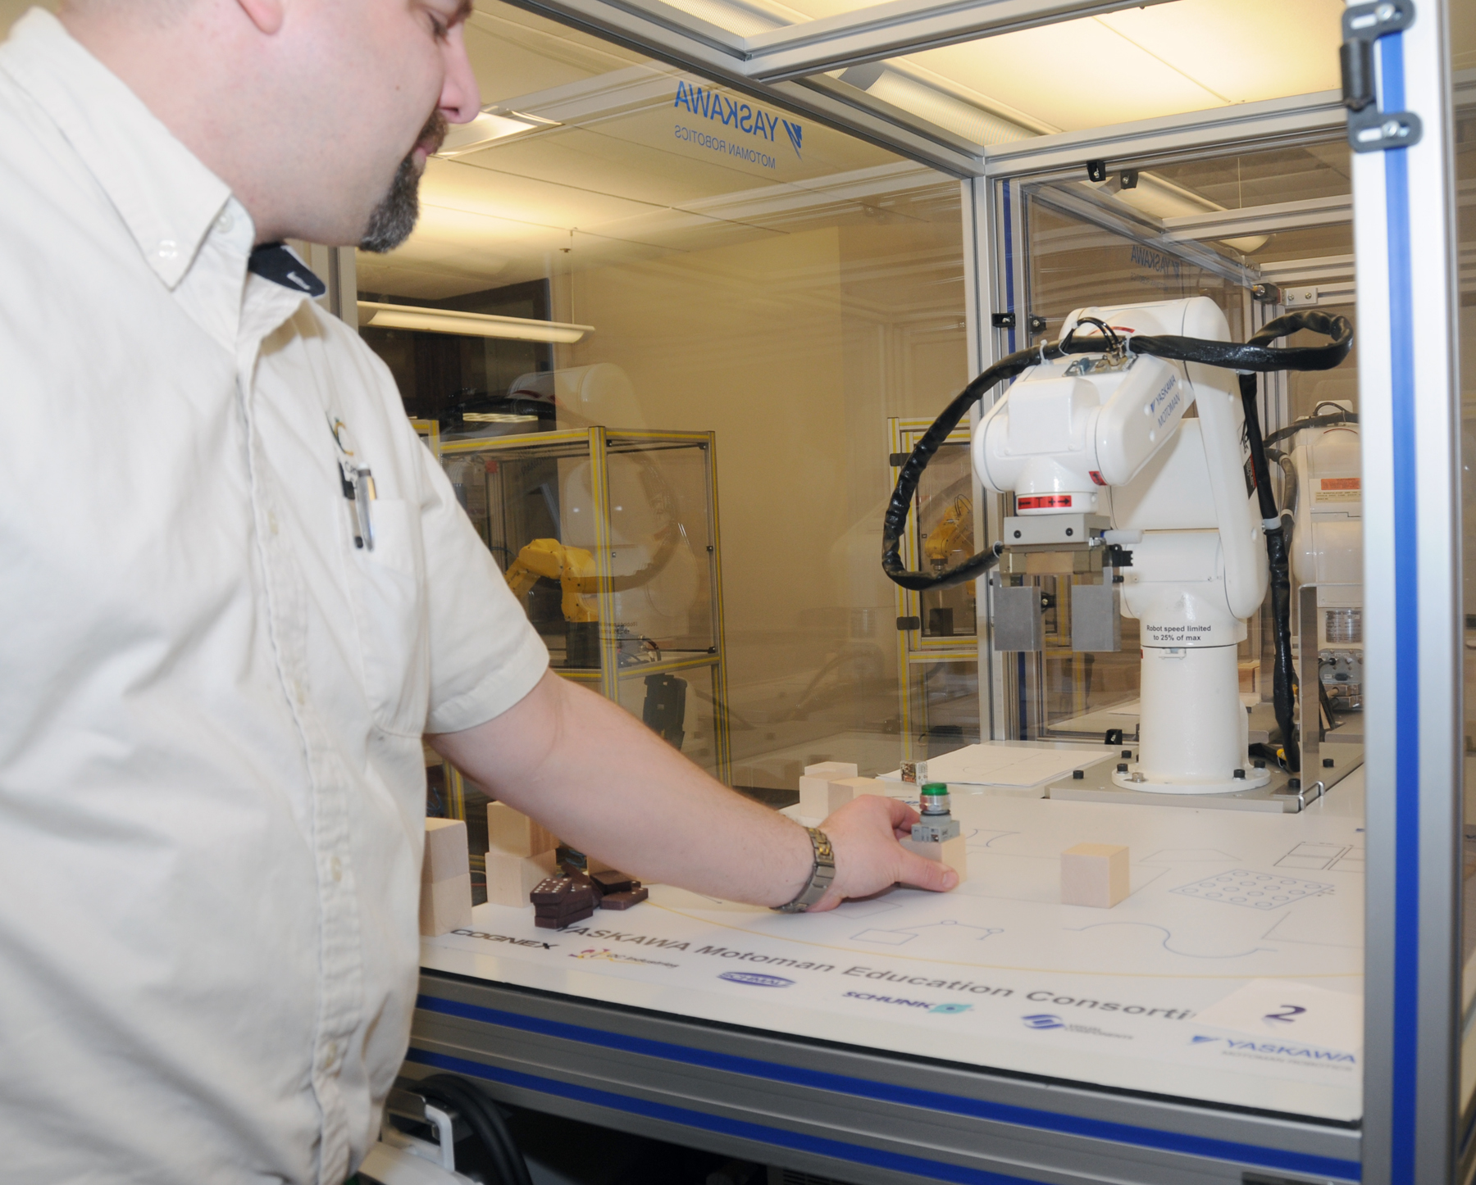
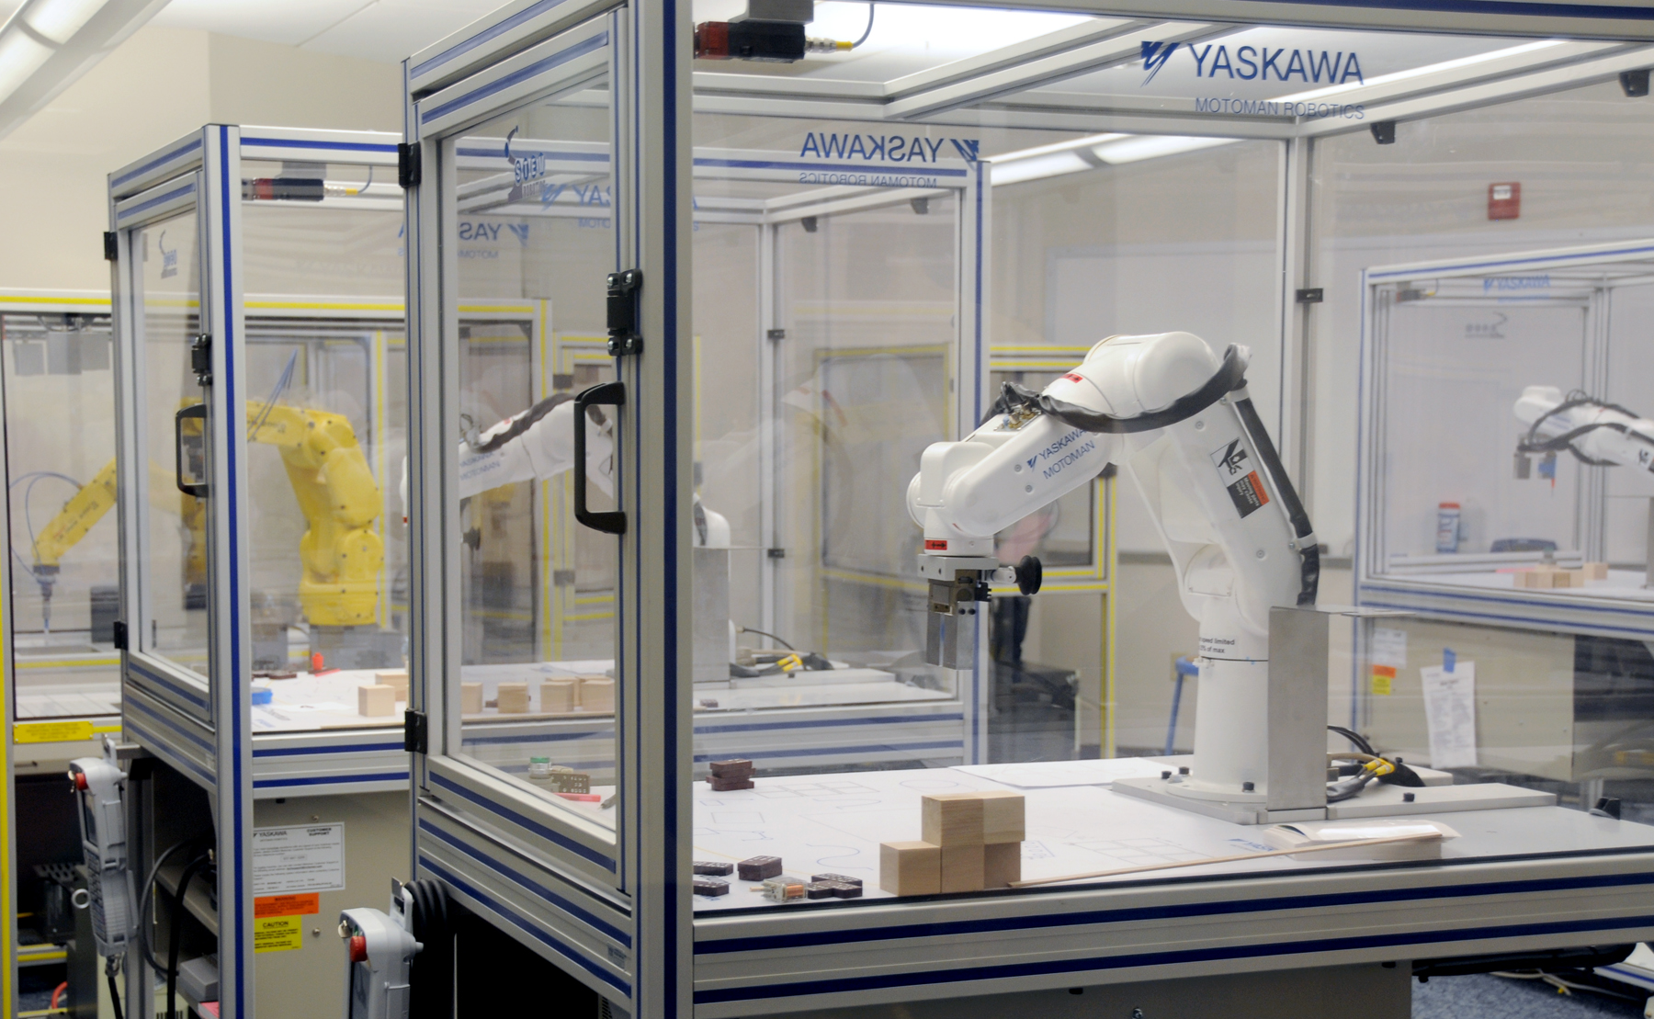
…Robots…
Automation & Robotics Technology

Slide 13
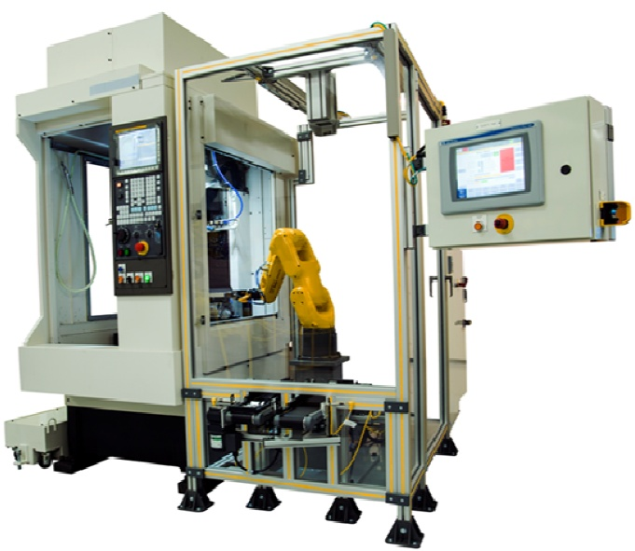
…and more Robots
RoboDrill

Slide 14
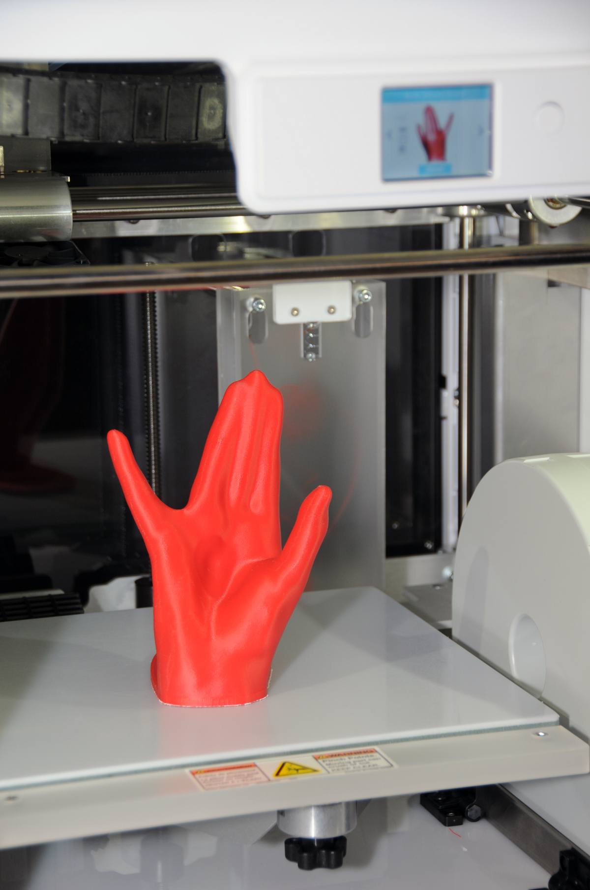
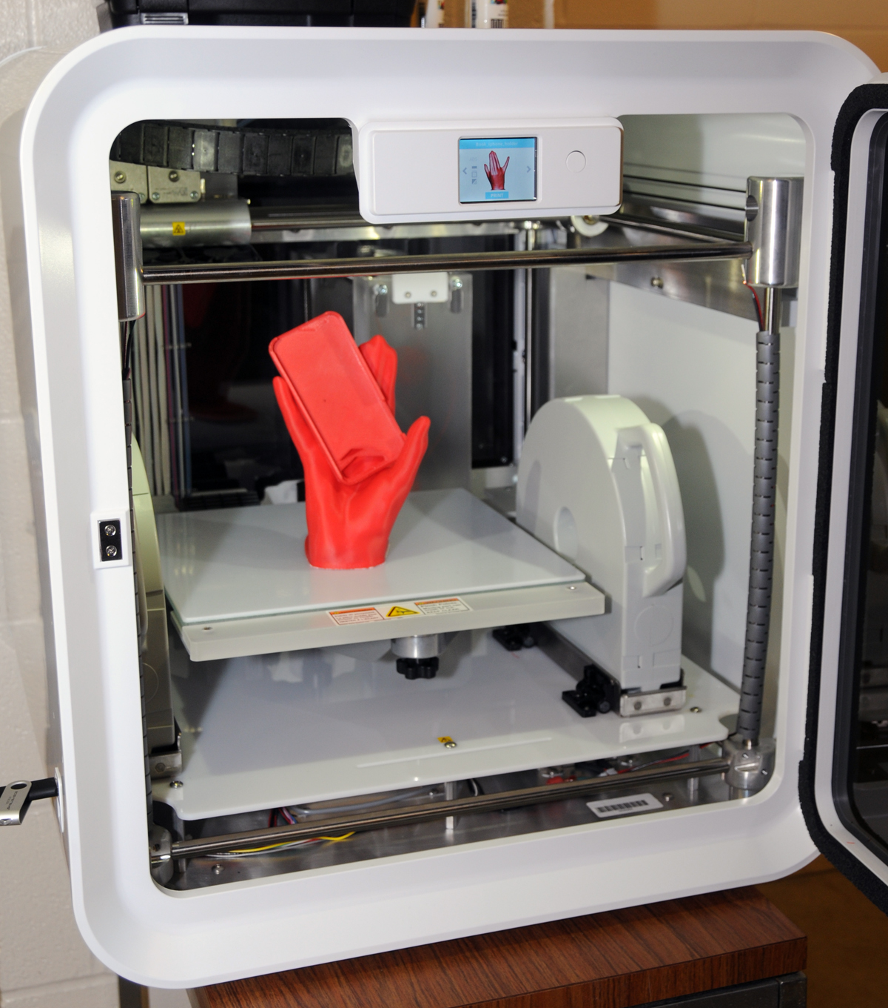
Entrepreneurial maker movement. Piloting and prototyping new product
Image printed on 3D printer

Slide 15
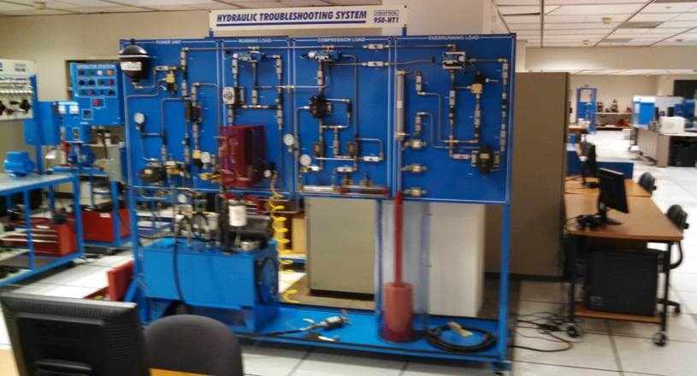
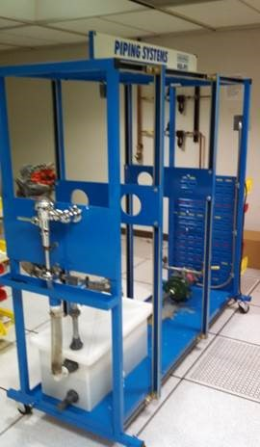
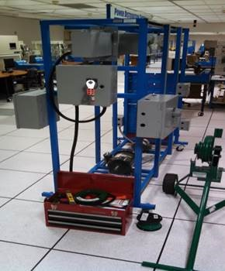
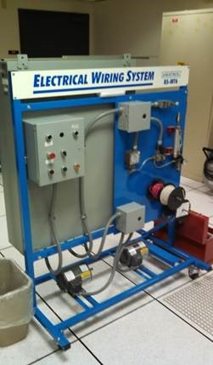
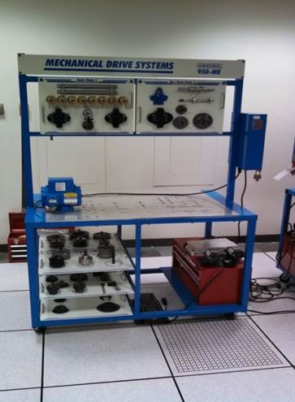
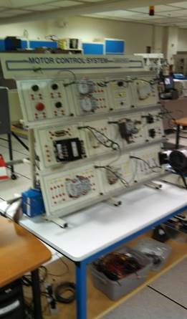
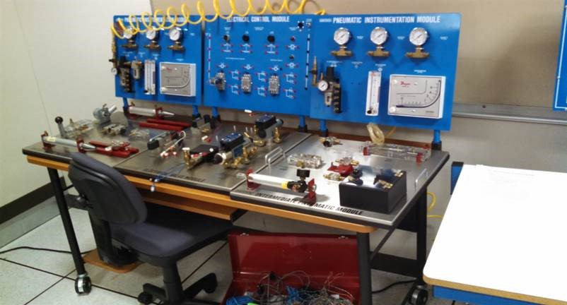
Hydraulic systems
Integrated Systems Technology (IST)
Laboratory
Piping Systems
Power Distribution Systems
Electrical Wiring Systems
Pneumatic Systems
Mechanical Drives
Motor Control Systems

Slide 16
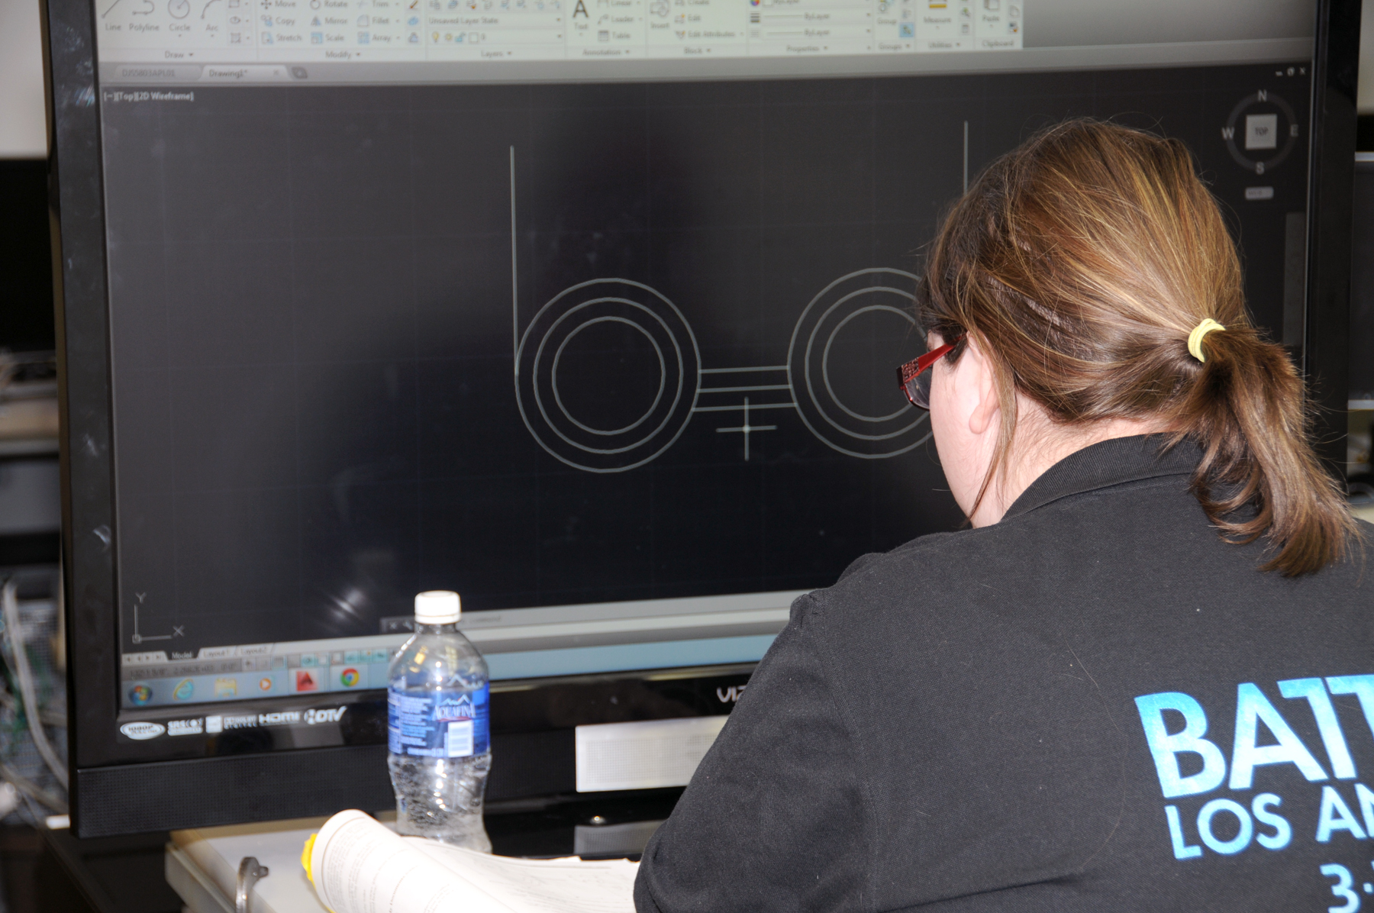
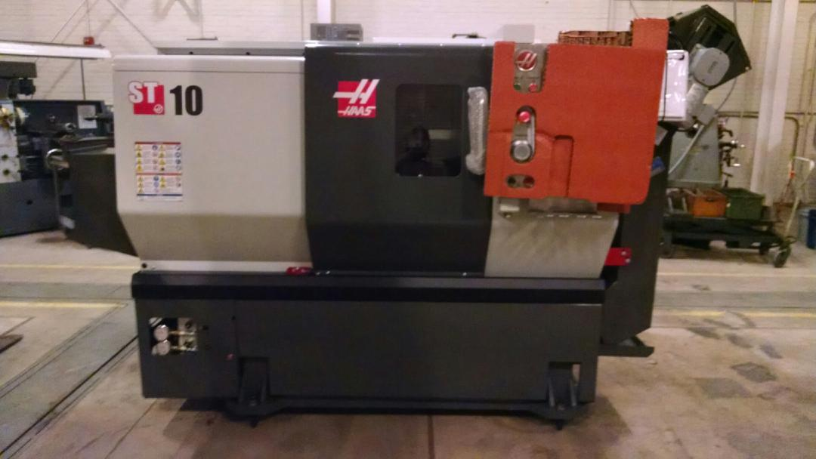
HAAS CNC Lathes &
Turning Centers
Computer Assisted Design (CAD)

Slide 17
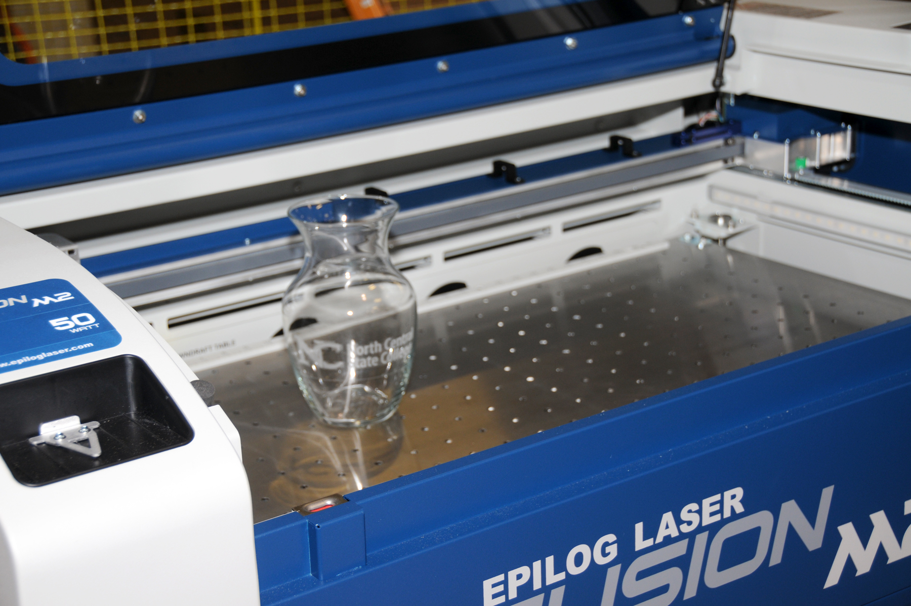
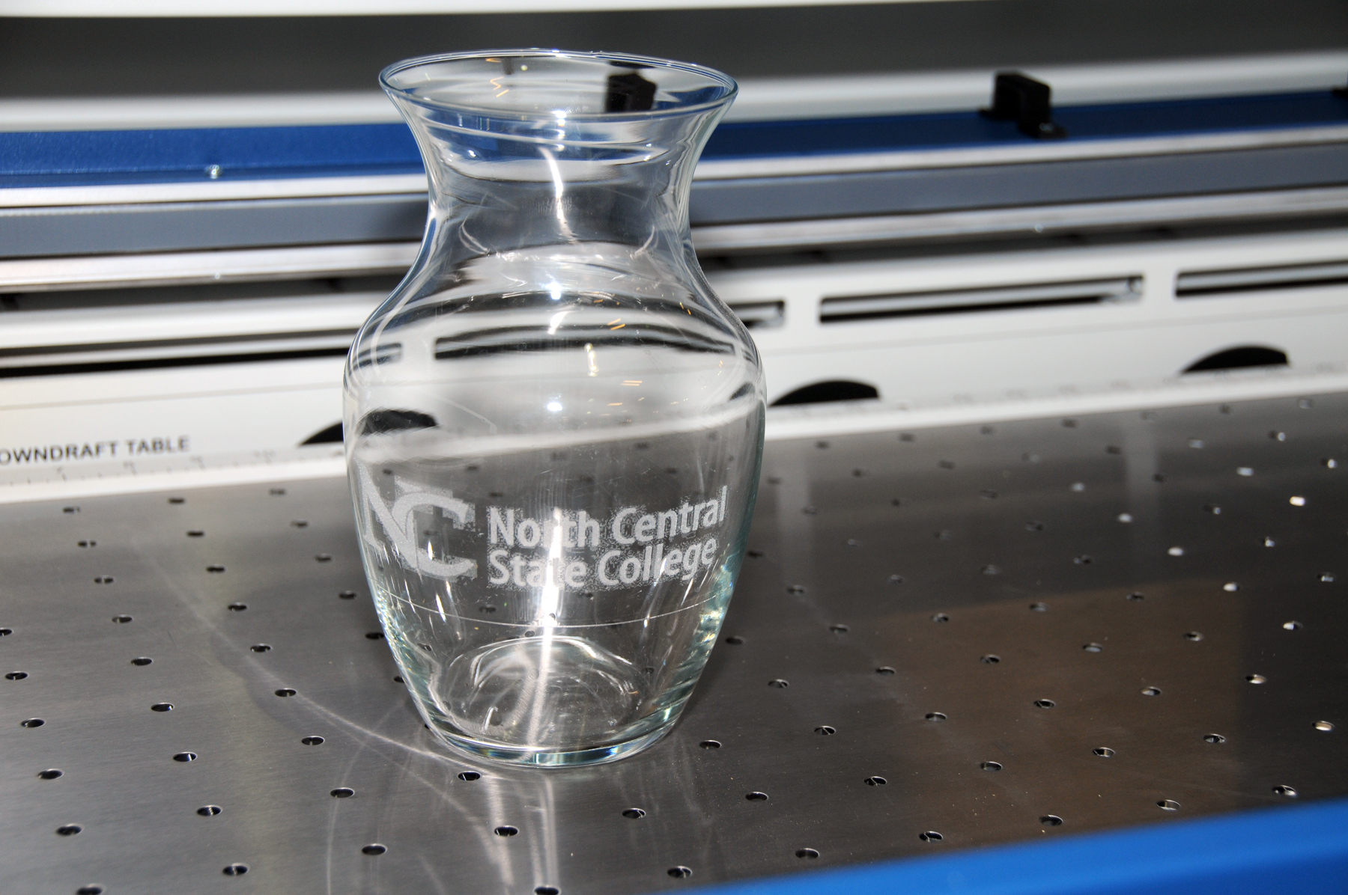
Opens new doors to possibilities
Laser Engraving Technology

Slide 18
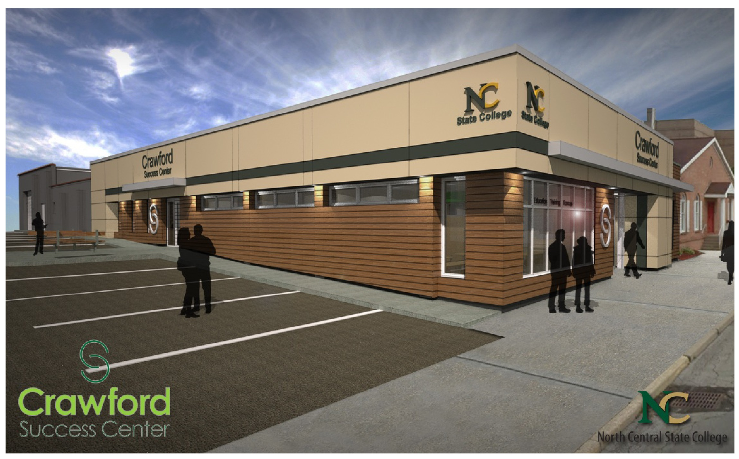
Lobby view (right side)
Lobby view (left side)
Crawford Success Center
Exterior view (Entrance)

Slide 19
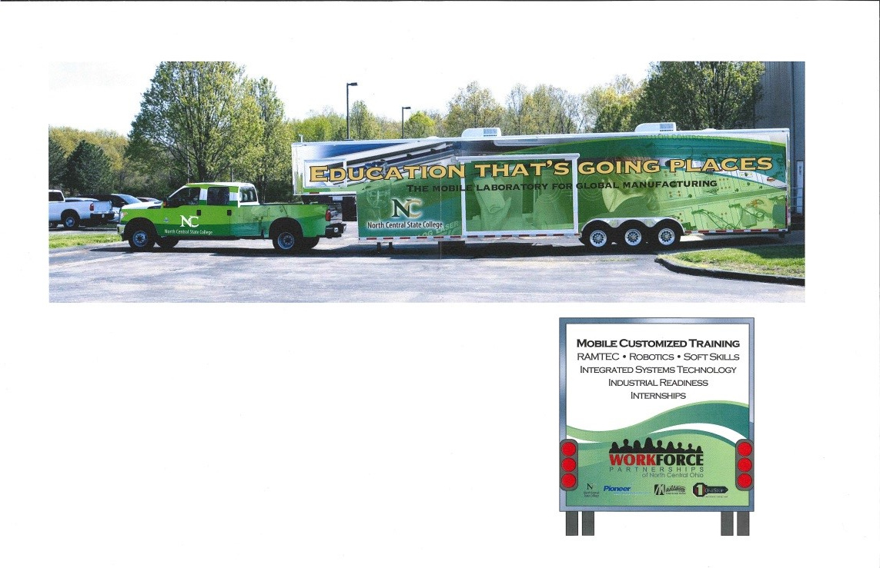
Mobile Training Center for the Workforce in partnership with Pioneer and Madison
(from the DOL Grant NC State received)

